Slide 1


NEXT GEN EMPLOYABILITY PROGRAM
CREATING A FUTURE-READY WORKFORCE
Student Name :
Pranav Krishnan B
Student ID :
Center Name :

Slide 2
CAPSTONE PROJECT SHOWCASE
Project Title
Crowd-Funding Web Application using React.js and Express.js
Abstract | Problem Statement | Project Overview | Proposed Solution | Technology Used | Modelling & Results | Conclusion

Slide 3
Abstract
1
"In today's dynamic fundraising environment, our Crowdfunding Web Application offers a modern solution for individuals and organizations to launch and support campaigns. With the increasing need for efficient online fundraising and transparent donation tracking, our project is designed to provide a seamless, user-friendly platform that empowers both campaign creators and donors, making a meaningful impact on social causes and personal projects..
2
"The Crowdfunding Web Application embodies innovation and practicality, offering a robust platform for users to create, manage, and contribute to fundraising campaigns seamlessly. Built with cutting-edge technologies like the MERN stack (MongoDB, Express.js, React.js, Node.js) and integrating secure payment simulation, our project ensures a smooth and user-friendly experience for both campaign creators and donors, driving impactful contributions to meaningful causes."
3
"Throughout its development lifecycle, the Crowdfunding Web Application underwent extensive testing and optimization to ensure high performance and reliability. A range of testing methodologies, including unit testing, integration testing, and user acceptance testing, were implemented to guarantee that the platform provides a smooth and secure donation experience while meeting the needs of both campaign creators and contributors."
4
"In conclusion, the Crowdfunding Web Application represents a significant leap in Full Stack Web Development. With its innovative features, secure donation process, and intuitive design, it has the potential to redefine how people contribute to causes. As we present the Crowdfunding Web Application today, we invite you to be part of this transformative journey in making meaningful impact through online fundraising."

Slide 4


Problem Statement
In traditional fundraising methods, the process of launching and managing campaigns for various causes often involves multiple platforms, complex payment systems, and a lack of real-time donation tracking. Donors face challenges in securely contributing to campaigns, while campaign creators struggle with managing donations, keeping track of progress, and ensuring transparency in the fundraising process.

Slide 5

Project Overview
The Crowdfunding Web Application is a comprehensive digital platform designed to simplify the process of creating, managing, and donating to fundraising campaigns. Utilizing modern web technologies like the MERN stack, the application provides a seamless, user-friendly interface for campaign creators to launch campaigns and for donors to contribute securely. With features like real-time donation tracking, campaign progress bars, and a secure payment simulation system, the platform ensures a smooth and efficient experience for all users.

Slide 6
Proposed Solution
The proposed solution for the Crowdfunding Web Application aims to provide a comprehensive platform that simplifies the process of creating, managing, and contributing to fundraising campaigns. Leveraging the MERN stack and best practices in web development, the solution focuses on addressing key challenges faced by campaign creators and donors, such as secure donation handling, transparent tracking of campaign progress, and an intuitive user interface for seamless navigation and participation.

Slide 7
Technology used
Backend: Node.js, Express.js
Frontend: React.js, CSS, HTML, JavaScript
Database: MongoDB
Authentication: JSON Web Tokens (JWT) and bcrypt for password hashing

Slide 8
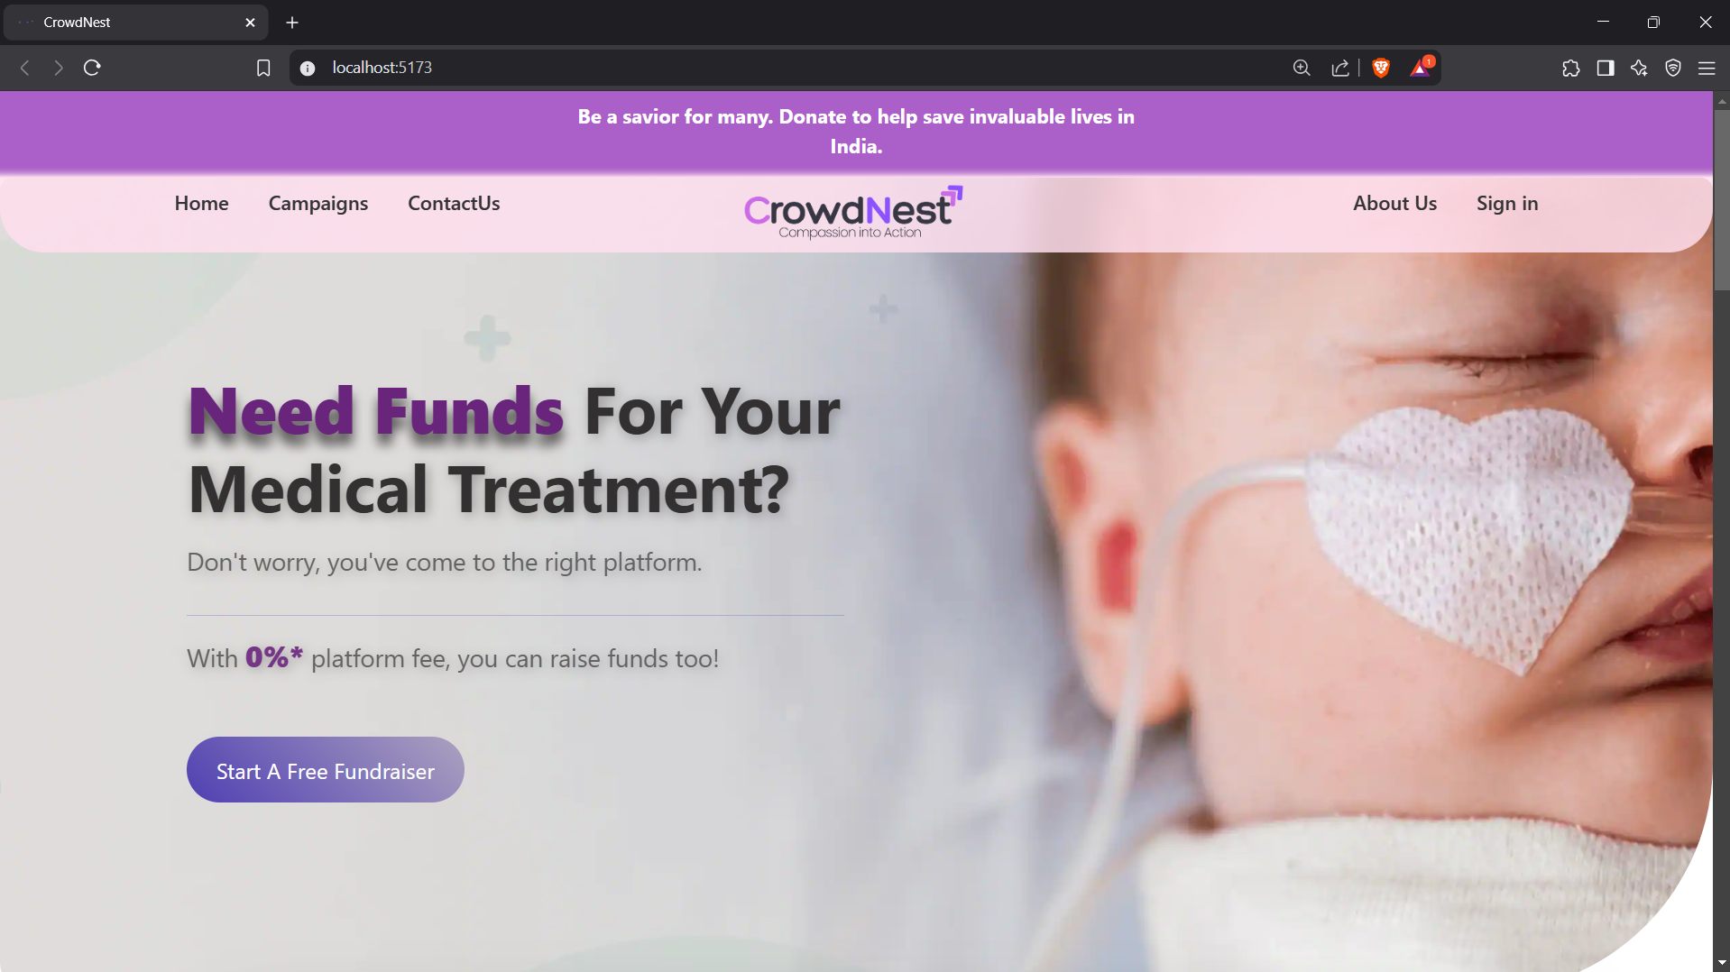
Modelling & Result 1
Landing Page

Slide 9
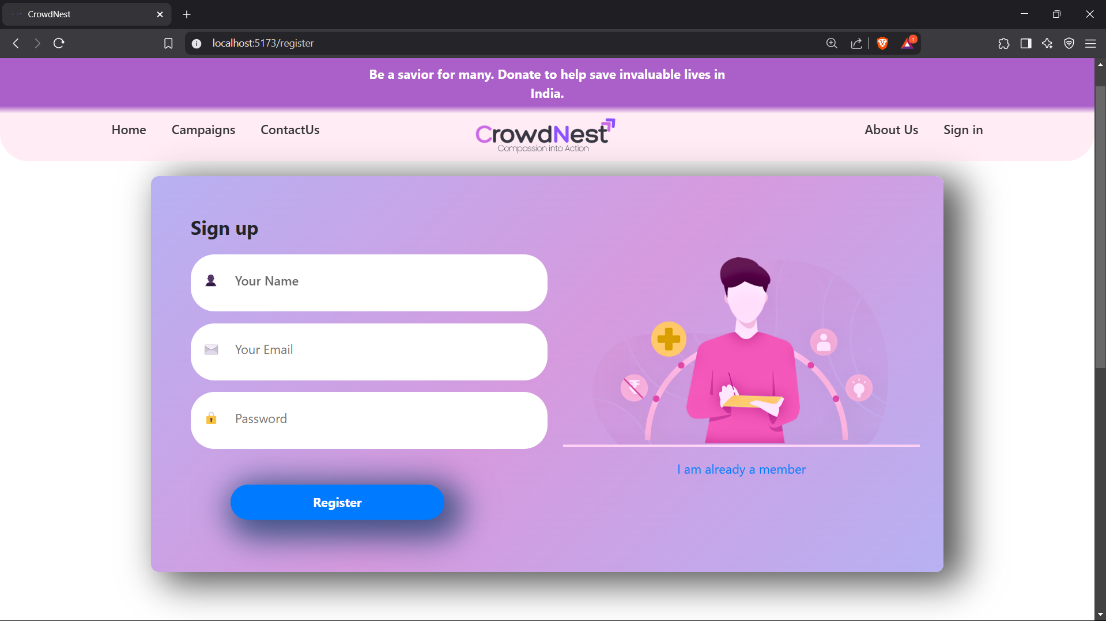
Modelling & Result 2
Default Registration Page

Slide 10
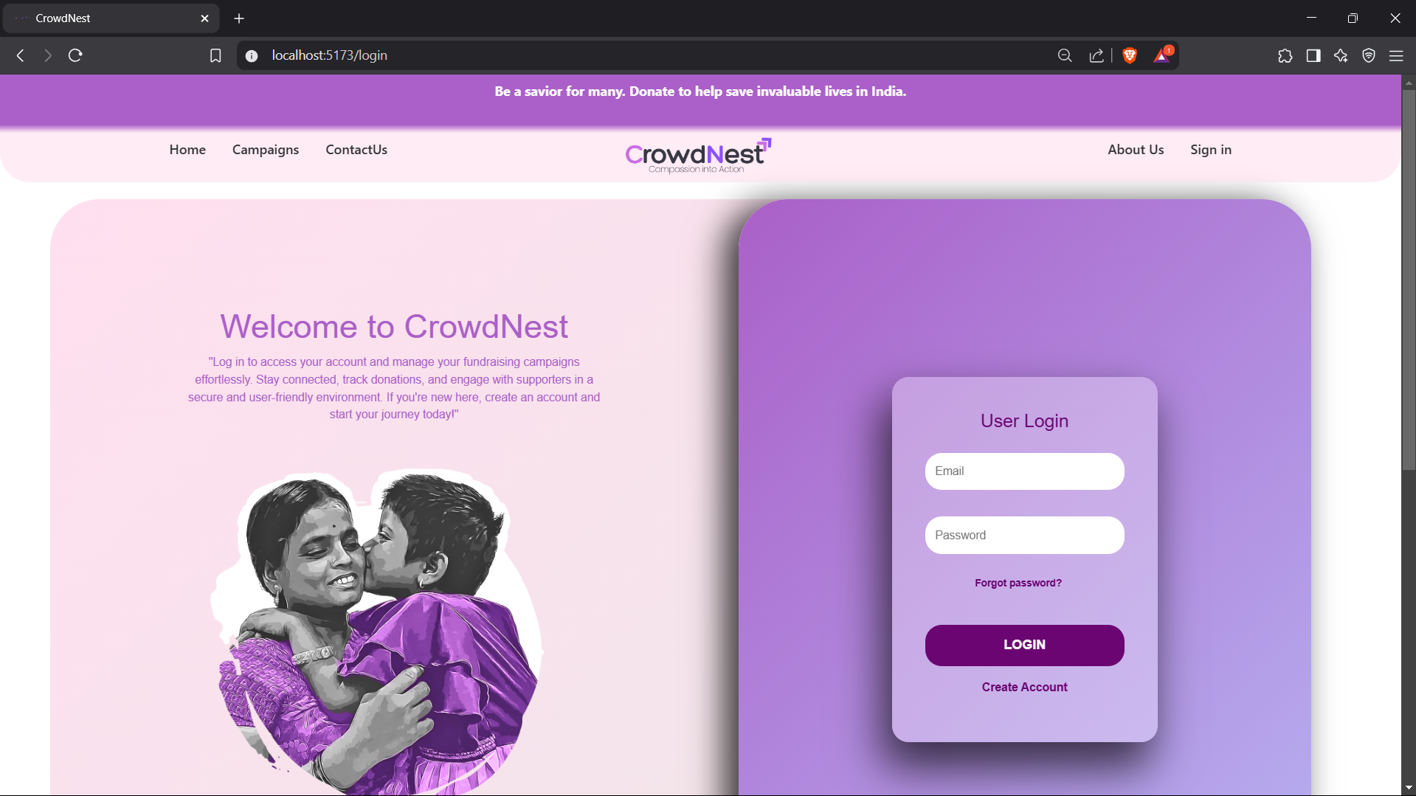
Modelling & Result 3
Login page

Slide 11
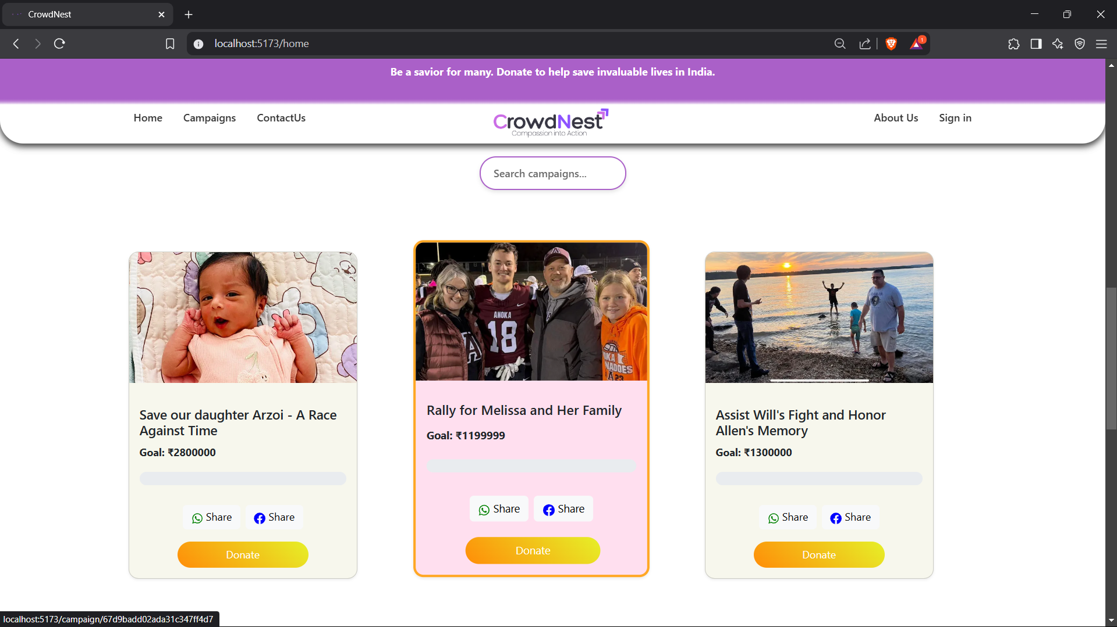
Modelling & Result 4
Home Page Showing Campaigns

Slide 12
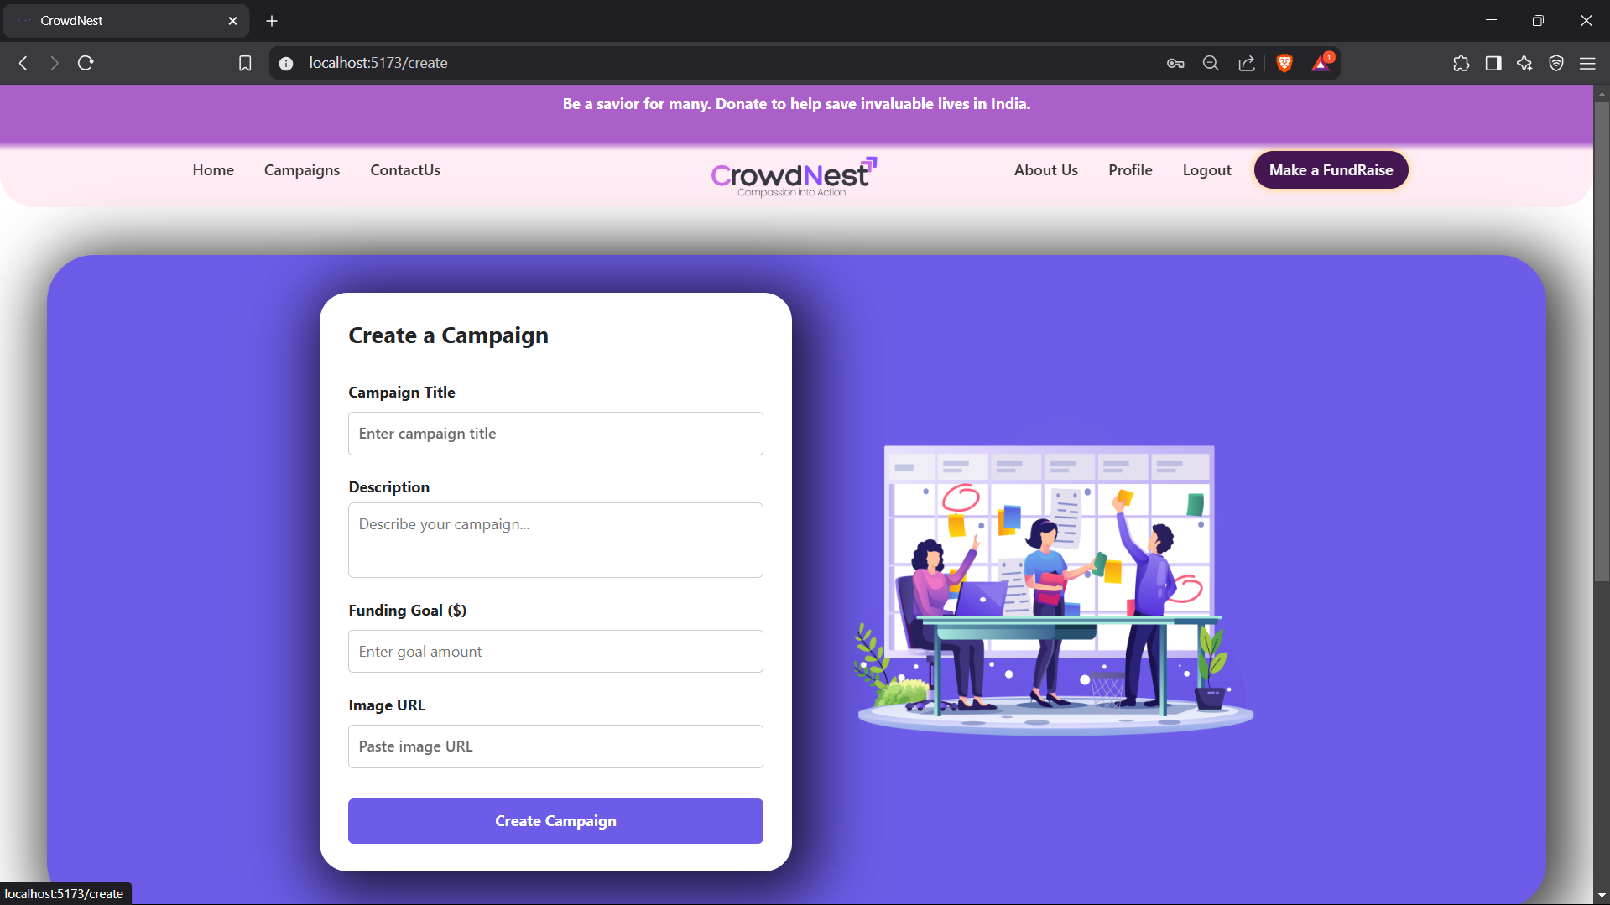
Modelling & Result 5
Campaigns Creation Page

Slide 13
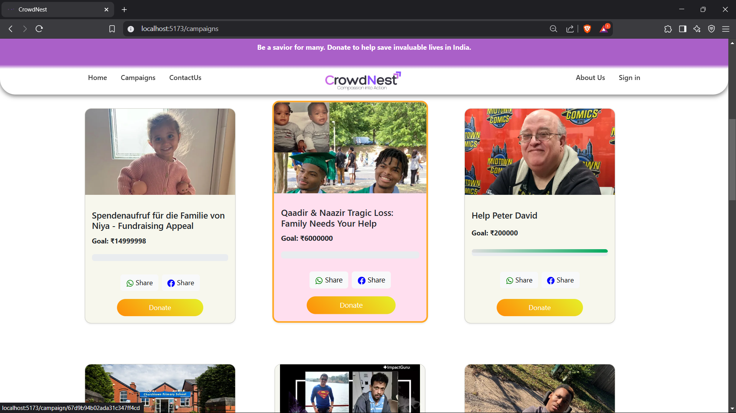
Modelling & Result 6
Campaigns Page

Slide 14
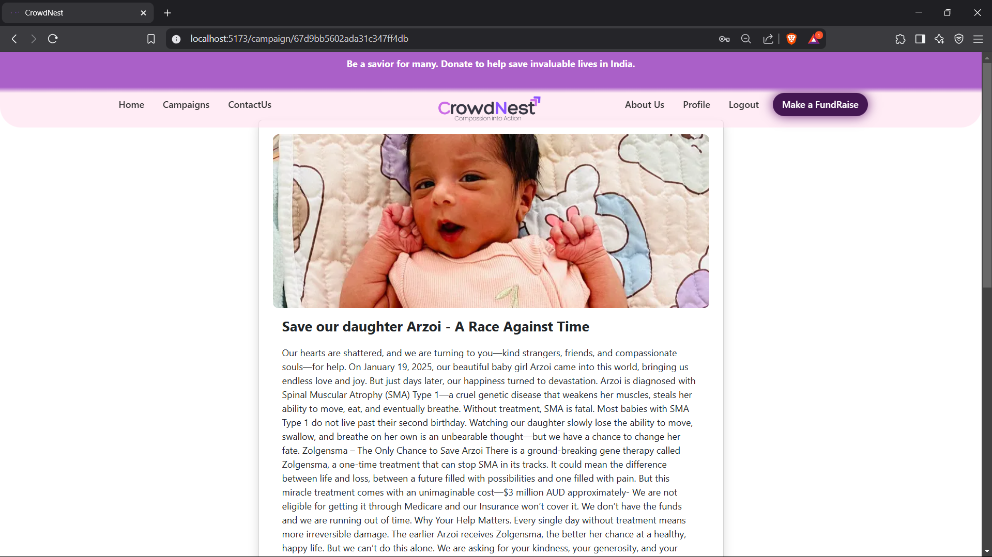
Modelling & Result 7
Campaign Detail Page

Slide 15
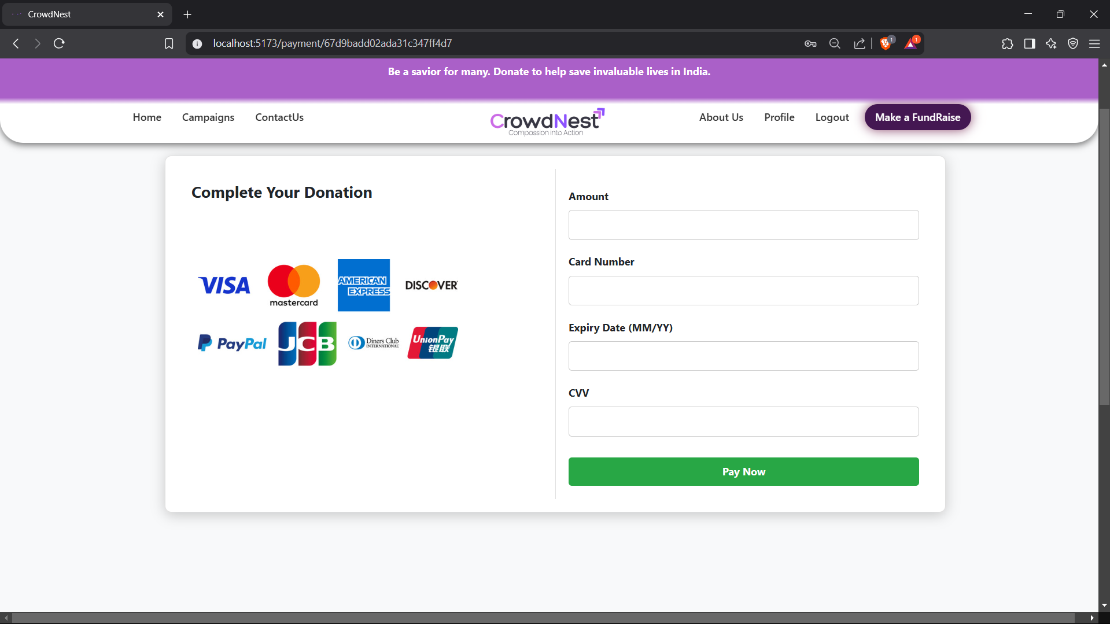
Modelling & Result 7
Donation/Payment Page

Slide 16
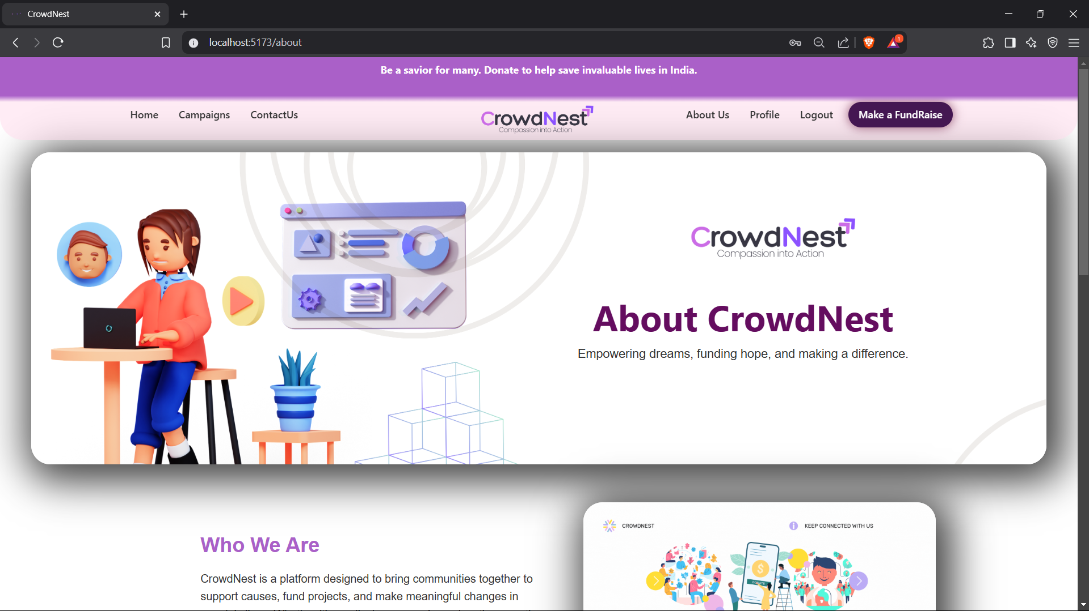
Modelling & Result 9
About Page

Slide 17
Conclusion
The proposed solution for the Crowdfunding Web Application combines innovative features, secure donation handling, and an intuitive design to meet the needs of both campaign creators and donors. By providing a centralized platform for launching, managing, and contributing to fundraising campaigns, the solution aims to streamline the donation process, enhance transparency, and empower users to make a meaningful impact on social causes and personal projects.

Slide 18


Notes:
Thank You !!

